Slide 1
Migrating UI Toolkit to WPF
Presented by Richard C. Morris

Slide 2
Migrating UI Toolkit to WPF
Presentation and hands-on
  Getting started
  Menu and toolbar processing
  List processing
  Input processing
  Field validation and change method processing
Notes:
The day will have a simple format – I talk then you’ll do some typing. Then coffee then do it all again.
We’ll step through these main areas of an existing UI Toolkit application and you’ll write the code to implement the same functionality using WPF!

Slide 3


Before We Start
Code snippets
  Available in Visual Studio
  Available in Workbench
{File_name.dbc}
{File_name.dbc}
Notes:
When you see these symbols on the screen with the associated file name, you can use the associated program (visual studio or workbench) to view the code being discussed – it may be easier than on the screen.

Slide 4
Getting Started
Simple UI Toolkit program
  Presents a list of “part” items
  Selecting an item enables “edit” mode
    Lookup data via drill methods
    Validate data using change methods
  Create new items using the File > New menu entry
  Close the program with File > Exit menu entry

Slide 5
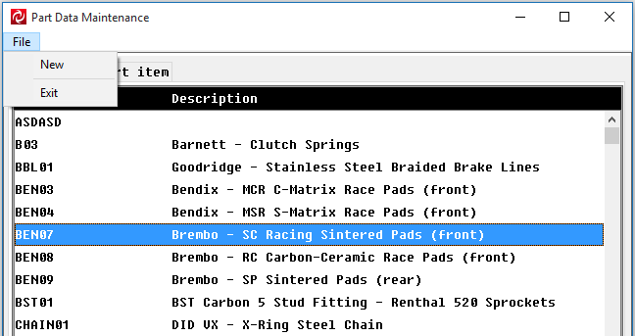
Part Data Maintenance
Create new
Exit program
Select items to edit

Slide 6
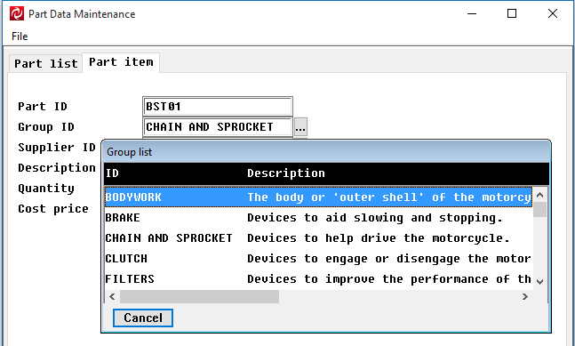
Part Data Maintenance
Drill to look up items
Select by double-click
Cancel lookup

Slide 7
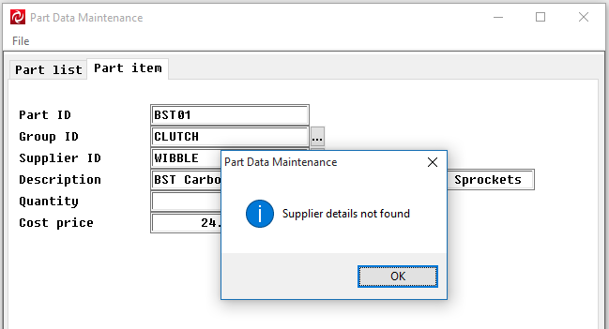
Part Data Maintenance
Change method validation

Slide 8

Part Data Maintenance
This will delete the record!
Save your changes
Cancel everything

Slide 9
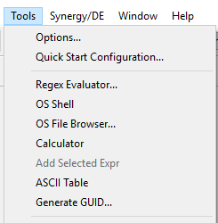
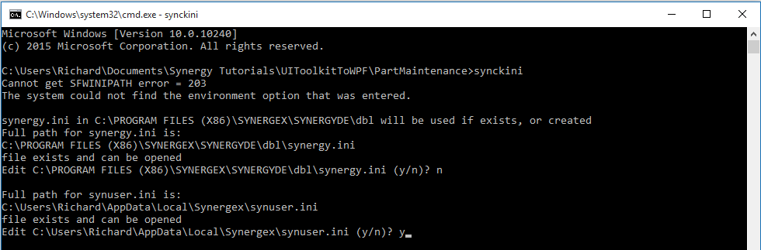
About Workbench
Opens a command window
Run SYNCKINI
Notes:
The instructions ask you to open a command window from within workbench – use the OS Shell entry from the tools menu.
The program name is SYNCKINI
Remember to edit the synuser.ini file not the synergy.ini file!!!!!

Slide 10

Getting Started
Use Workbench
Run the UI Toolkit application
  Get a feel for what it does – it’s very simple ☺
Configure our system for our new WPF shell
Grab a coffee ☺
Hands-on #1
Notes:
What are we going to be doing for our first hands-on exercise?
Run up workbench.
Build and execute the existing UI Toolkit program – understanding what it does!!
Configure the system to run our new WPF shell.

Slide 11
Menu & Toolbar Processing
Cornerstone of a UI Toolkit program
  No menu = no functionality
  Menu signals come from:
    Menu entries
    Toolbar buttons
    Input/list/window buttons
    Code (m_signal())
  Limited to 15 characters if using existing “g_entnam” processing code
  Global variable “g_select” must be set to true

Slide 12
Example
{ui.wsc}
Menu column
Created in script
Loaded in code (name of column important)
Menu event signalled when column entry selected
  Entry name important
  Max 15 characters
.column c_file, "File"
.entry f_new, "New"
.line
.entry f_exit, "Exit"
.end

Slide 13
Not Supported
Create menu columns at runtime
  MB_COLUMN
  MB_ENTRY
  MB_END
Not supported – we don’t currently support generating menu columns/entries at runtime when migrating to WPF ☺

Slide 14
Example
Toolbar
Created in code – no script equivalent
Button “name” signalled

Slide 15
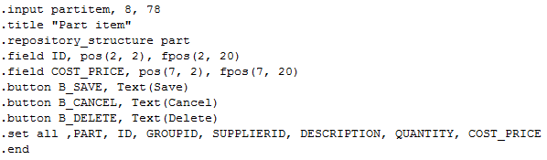
Example
{ui.wsc}
Input window
Button name is signalled as menu entry name

Slide 16

Example
List processing
Button name is signalled as menu entry name
Created in code – no script equivalent

Slide 17

Example
Tab container processing
Button name is signalled as menu entry name
Created in code – no script equivalent

Slide 18
Controlling Menu Event Signalling
{part_input.dbl}
Controlling status of controls

Slide 19
Symphony UI Toolkit
ToolkitCommand
  Base class to enable menu signal processing
  Extends the Symphony Conductor RoutedCommandBase
  Provides command enablement and visibility
CommandController class
  Define a dictionary of ToolkitCommand commands to enable menu signal processing
  Methods include
    LoadCommand – load a “command”
    EnableCommand/DisableCommand
  Inject the “event handler” raised when the menu signal is raised

Slide 20
Menu processing
MenuController class
  Exposes a CommandController class to enable menu event style processing
LoadCommand
  Load a command into the controller class
    Define its name (the menu to signal)
    Assign the event handler
      Executed when the data-bound command is executed
    Define visibility
      All commands should be defined
EnableCommand/DisableCommand
  Change status of a data-bound command
PlaceColumn/RemoveColumn
  Hide/reveal groups of commands

Slide 21
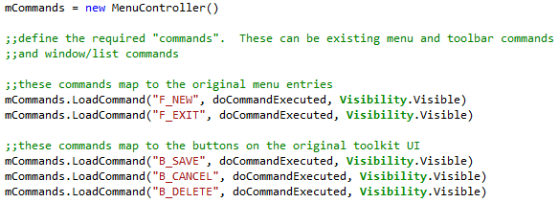
Menu Processing Example
Menu name
Notes:
This is how we create the commands. These need to map to the commands our exiting program is expecting.

Slide 22
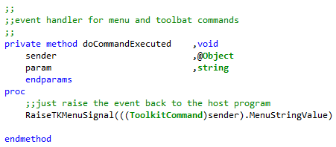
Event Handler
{PartMaintenanceViewModel.dbc}
Synergy .NET code
Notes:
When the command is selected, or executed, we need to signal back to the host DBL program

Slide 23
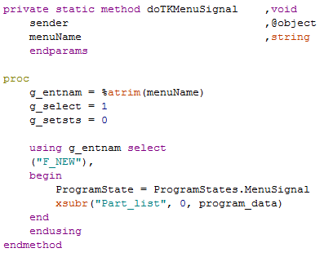
Event Handler
DBL code
Menu name
Notes:
In the DBL code we need to handle the event and dispatch to the right piece of code.

Slide 24
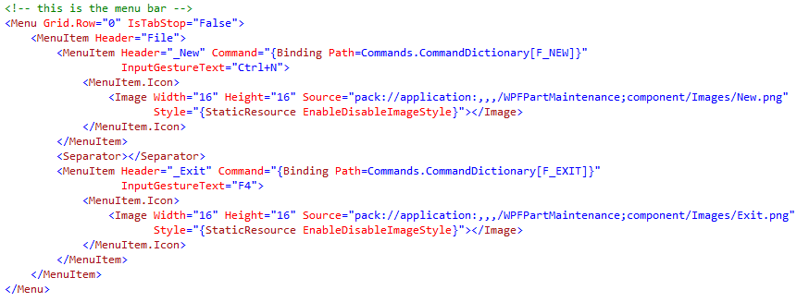
UI: Menu Bar
{MainView.xaml}
Menu name

Slide 25
UI: Menu Bar
Menu name
Enable a menu command
Disable a menu command
Program view model

Slide 26
Toolbar Processing
Menu and toolbar share commands
Inject your “MenuController” into the ToolbarController
Enable/disable items as required

Slide 27
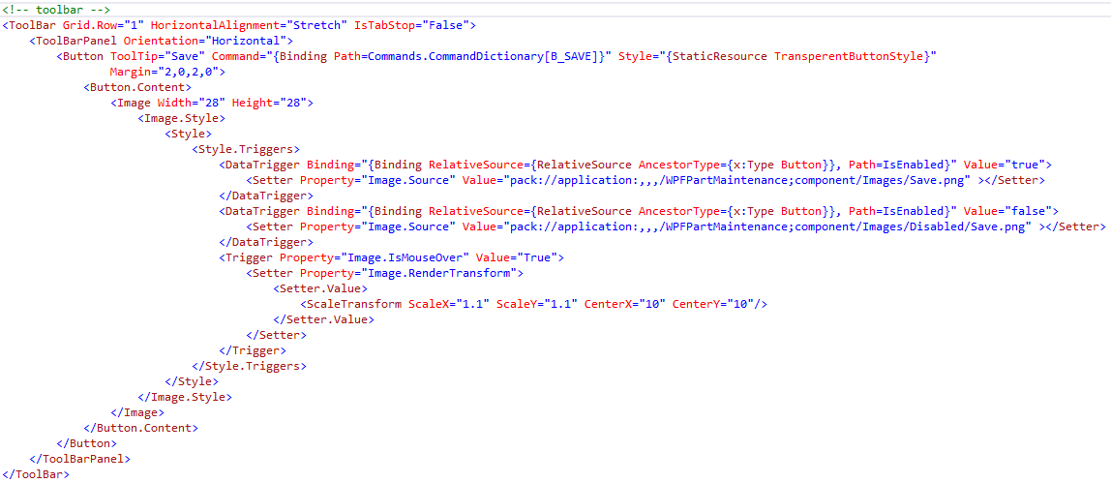
UI: Toolbar
Menu name

Slide 28
Menu & Toolbar Processing
Build menu commands
Add event handler
  Handle menu event signals
  Dispatch to the original program code
Enable/disable commands
Grab a coffee ☺
Hands-on #2

Slide 29
List Processing
Present collection of data
List “window” defined in script
  How each line of the list will look
List class defined in script
  defines list attributes
Load method responds to load requests
  Populate the list
Selection “loop” processes the list
  Terminates on menu signal/list item selection

Slide 30
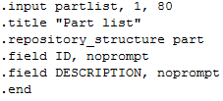
Example
{ui.wsc}
Input window
Created in script
Loaded in code (name of window important)

Slide 31

Example
{ui.wsc}
List class
Created in script
  Defines load method
Referenced in code

Slide 32

Example
{PartMaint.dbl}
Create the list
Created in code
  Must load the window first
  Reference the list class
  Headers can only be created in code

Slide 33
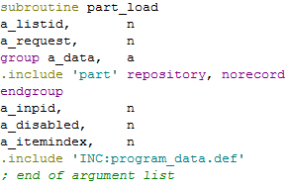
Example
{part_load.dbl}
Load method
Defined argument list

Slide 34

Example
{part_load.dbl}
Load method
  Loads required data
  Two main functions
    Display the list data to the list view (input window)
    Return the data to calling list processor
Not when running under WPF!!!
Returned data

Slide 35
Symphony Data Object
Represents the repository structure
  Defines fields as properties
    UI data-binds to these properties
    Signals data changed events to force UI to update
  Defines a SynergyRecord property
    Populate the data object with the record data

Slide 36
Collections
Type safe array
AsyncObservableCollection
  Extends the base ObservableCollection
  Provides thread-safe methods
    AddToCollection()

Slide 37
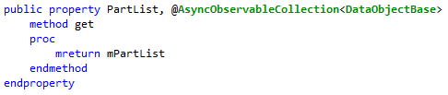
Collections
Expose collection to the UI

Slide 38
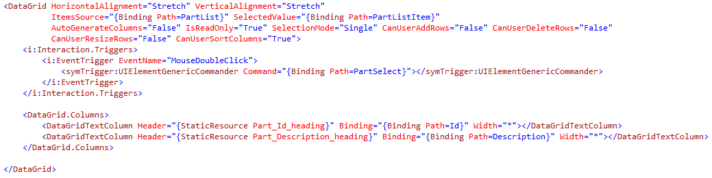
UI: DataGrid
{PartList.xaml}
Represent tabular data
  Data-bound to our collection of data objects
Data-bound collection
Data field binding
Column headings

Slide 39
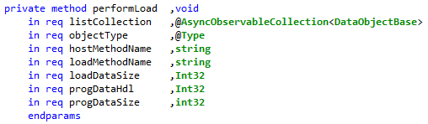
Perform “Load Method” Processing
{PartMaintenanceViewModel.dbc}
Call internal method to raise event to “load” data
Internal method

Slide 40
Perform “Load Method” Processing
{PartMaintenanceViewModel.dbc}
Raise event to host DBL program

Slide 41


Handle “Load Method” Event
Add an event handler
Call the original “load method” routine
Prevent display of data in the “load method”

Slide 42
List Processing
Raise event to load collection
Register event handler
Call into original load method routine
Modify load method routine to suppress UI
Populate data using SynergyRecord property
Grab a coffee ☺
Hands-on #3

Slide 43
Input Processing
Window containing editable data fields
Defined in script
  Ideally from repository based data
Processing “loop” responds to
  Menu signal
  Input set complete

Slide 44
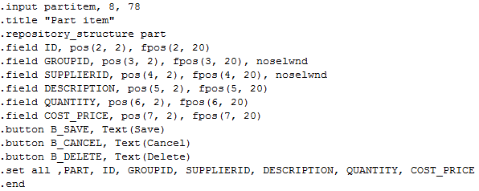
Example
{ui.wsc}
Input window
Created in script
Loaded in code (name of window important)
Input sets

Slide 45
Input Window
Field defines type, size, etc.
Prompt information
Method processing
  Drill and change methods
Validation rules
All attributes taken from the repository structure
  The preferred way!!

Slide 46
Example
{MainLine.dbl}
Load window
  Window name important

Slide 47
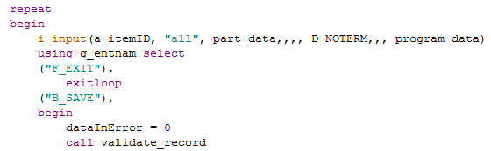
Example
{part_input.dbl}
Process window

Slide 48
Symphony Data Object
Represents the repository structure
  Defines fields as properties
    UI data-binds to these properties
    Signals data changed events to force UI to update
  Defines a SynergyRecord property
    Transfer the object data with the program record data
Field validation
  Set field “valid”
  Set field “Invalid”

Slide 49
Symphony Data Object
Field initialization
Moving data
Move object data to local program record area
Raises property
change notifications

Slide 50
Symphony Data Object
Field states
  Enable/disable
Read only states
Fields names or *ALL*
Fields names or *ALL*

Slide 51
Styles
Define the attributes of a data entry point
  Repository based
  Code generated
Define prompt text
  Data-linked to the field
  Renditions change when field disabled
Define header information
  For use in grids

Slide 52
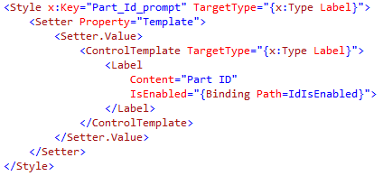
Styles
{Part_Style.CodeGen.xaml}
Header
Prompt

Slide 53
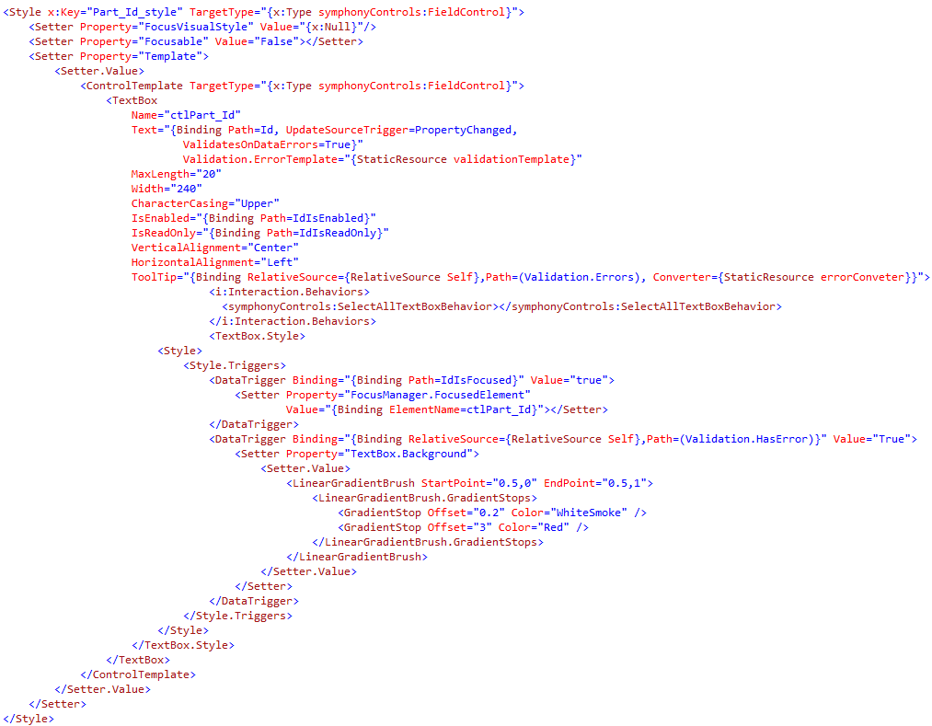
Styles
{Part_Style.CodeGen.xaml}
Field

Slide 54

Styles
{Part_Style.CodeGen.xaml}
Field
Unique name
Anchor point

Slide 55
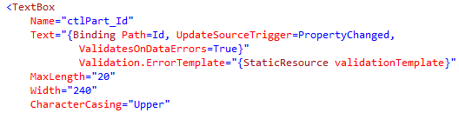
Styles
{Part_Style.CodeGen.xaml}
Field
Field entry type
Field data binding
Basic attributes

Slide 56

Styles
{Part_Style.CodeGen.xaml}
Field
Controlled by code
Visual attributes

Slide 57
Styles
{Part_Style.CodeGen.xaml}
Field
Control sets selection when editing
Tooltip displays error information

Slide 58
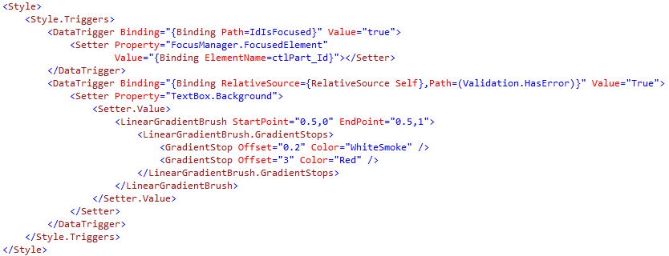
Styles
{Part_Style.CodeGen.xaml}
Field
Control field focus
Field “in error” styling

Slide 59
Input
{PartInput.xaml}
Field prompt
Field data binding
Anchor point

Slide 60
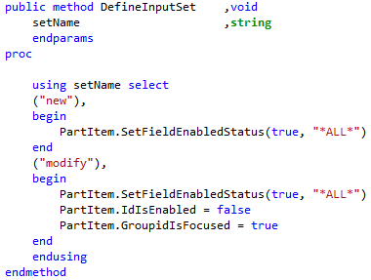
Set Processing
{PartMaintenanceViewModel.dbc}
Define “set” in the view model

Slide 61
Input Processing
Handle input set processing
Initialize data
Display “selected” records
Grab a coffee ☺
Hands-on #4

Slide 62
Field Validation & Change Method Processing
Execute existing change method logic
  Suppress UI
  Alternate “error” notification

Slide 63
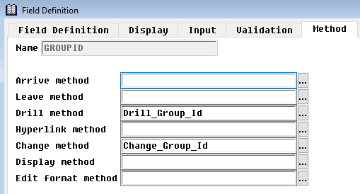
Example
Field level change method definition
Can be defined in script
Method name

Slide 64
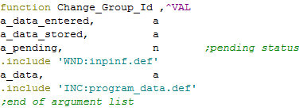
Example
{Change_group.dbl}
Change method interface
Information not available

Slide 65
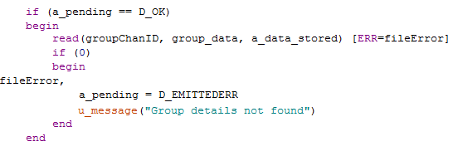
Example
{Change_group.dbl}
Validation logic
We stop the user in their tracks!

Slide 66
Symphony Data Object
Represents the repository structure
  Defines fields as properties
    UI data-binds to these properties
    Signals data changed events to force UI to update
  Defines a SynergyRecord property
    Transfer the object data with the program record data
Method invocation
  Define event handler
Raised when the data changes

Slide 67

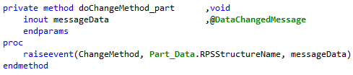
Change Method Processing
ViewModel delegate/event
Raise event when change method invocation signalled

Slide 68
Handle “Change Method” Event
Add an event handler
Call the original “change method” routine
Alternate error notification
Input field renditions changed

Slide 69
UI: Status Bar
Display “processing” information
  UI Toolkit
  WPF

Slide 70
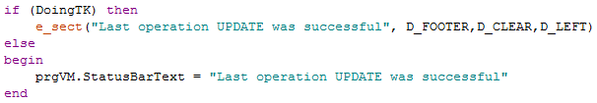
UI: Status Bar
Display status bar information

Slide 71
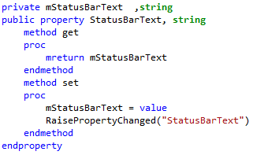
UI: Status Bar
ViewModel method
Part of Symphony.Conductor.ViewModelBaseViewModel

Slide 72

UI: Status Bar
XAML

Slide 73
Field Validation & Change Method Processing
Define a delegate/event pairing
Bind to method invocation event
Process change method request
Modify change method code to supress UI
Add “status” information
Grab a coffee ☺
Hands-on #5

Slide 74
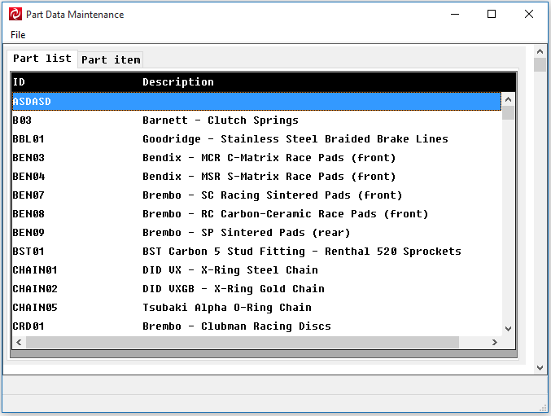
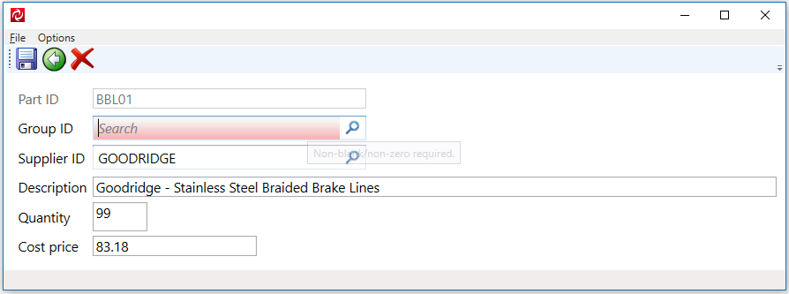
SYMPHONY_RUNNING_WPF=False
SYMPHONY_RUNNING_WPF=True

Slide 75
Thank you
Migrating UI Toolkit to WPF

